Slide 1
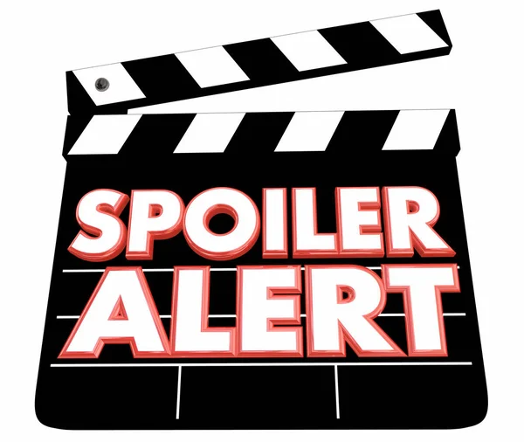
Movie Reviews: To Read or Not to Read! Spoiler Detection with Applied Machine Learning

Slide 2

Would you still watch The Avengers if you found out that Iron Man dies at the end? Would you watch the final season of Game of Thrones if somebody told you Bran was going to be the king of the North?
Highly Unlikely!

Slide 3
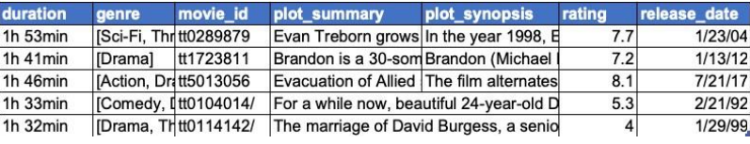
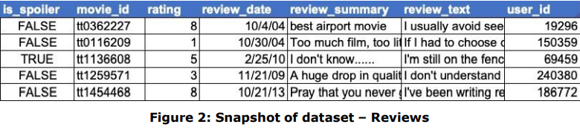
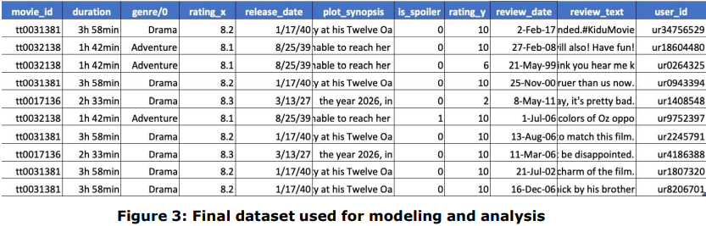
DATA

Slide 4
Characteristics
Target Variable:
- Is Spoiler?
Independent Variables:
Movie id
Duration
Genre
Rating
Release date
Plot synopsis
Review text
User ID
-This dataset consists of 70% spoilers and 30% non-spoilers. For modeling purposes, a balanced dataset is created with 50% spoilers and 50% non-spoilers for training data.
-Sampling is applied only to the training dataset keeping in mind that the dataset won’t exhibit a 50-50 ratio in real life.

Slide 5
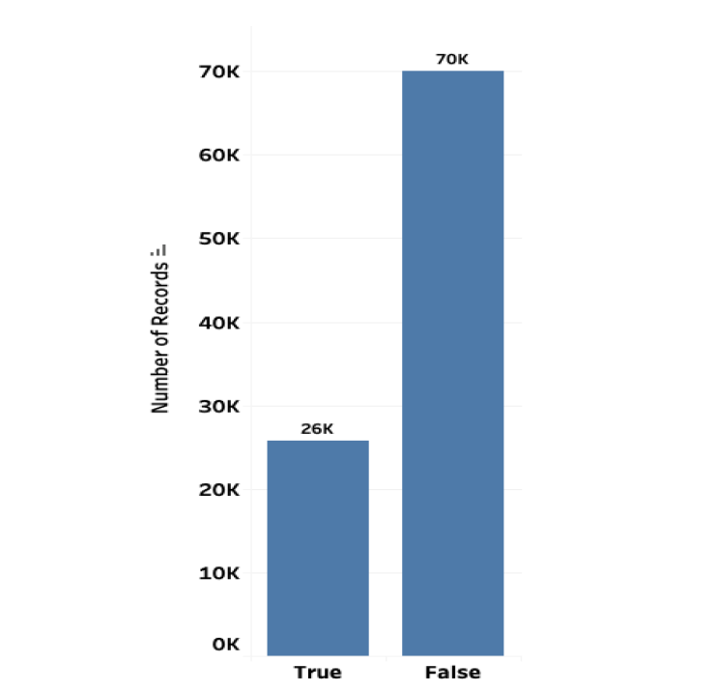
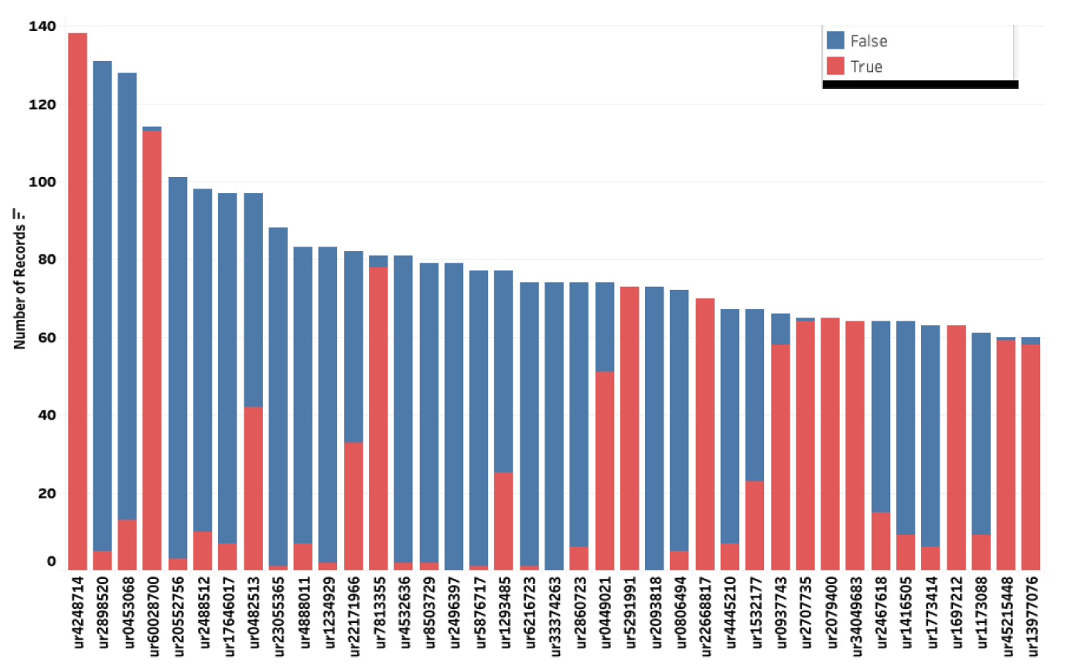
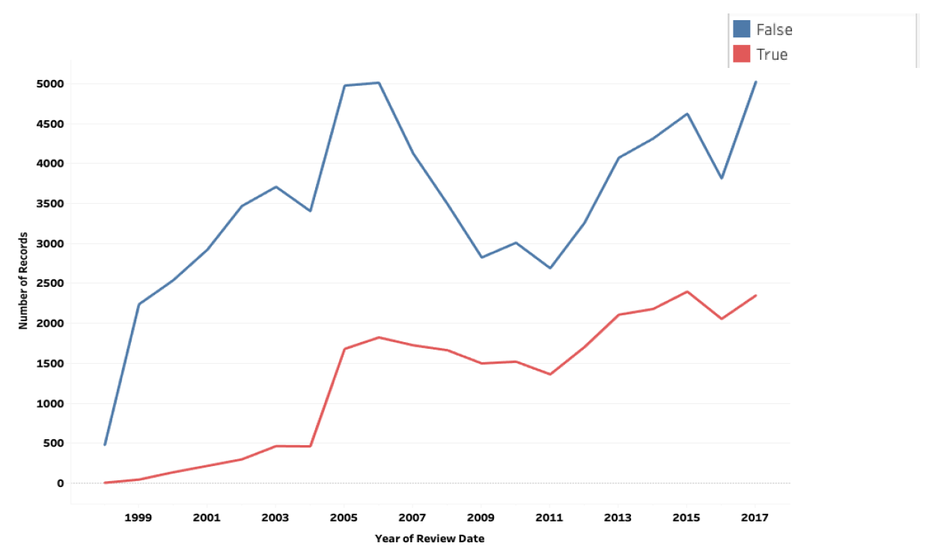
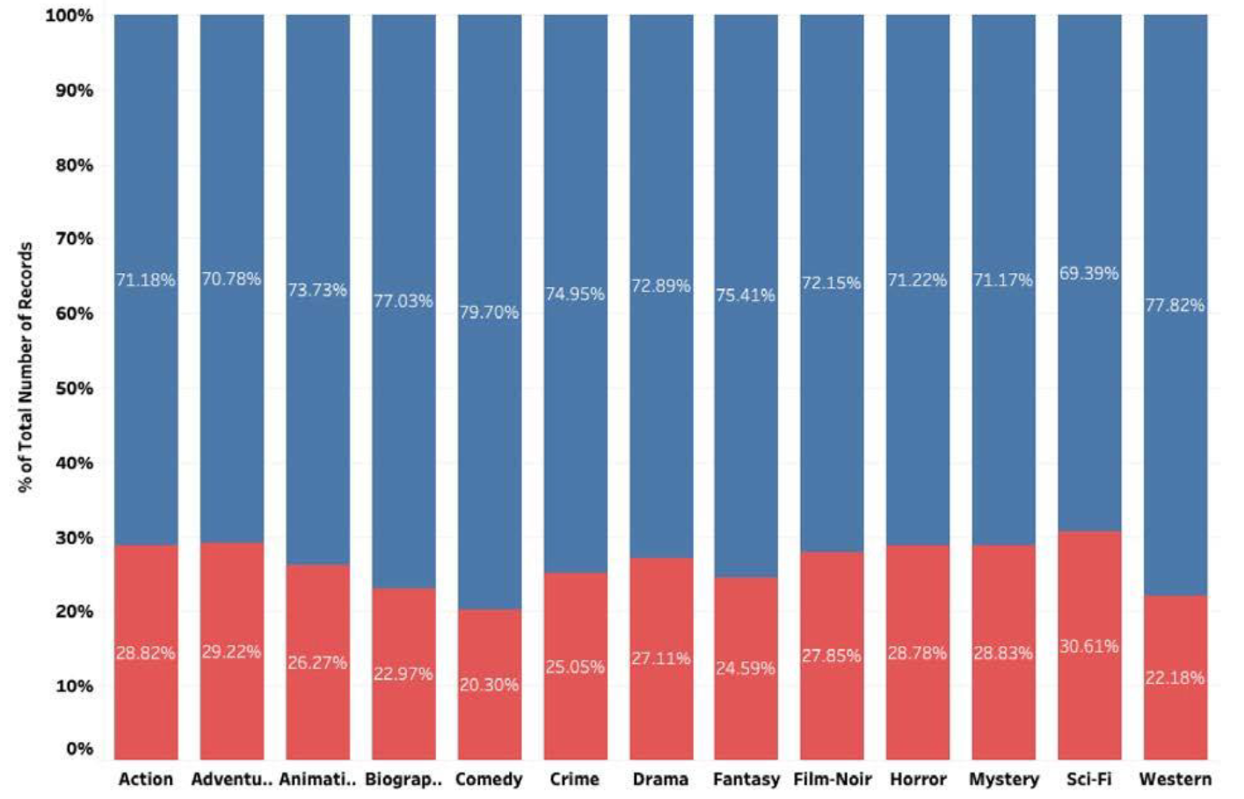
EXPLORATION
Spoiler vs NS reviews
Reviewers – highest number of reviews
Trend of spoilers over time
Spoilers in reviews w.r.t genre

Slide 6
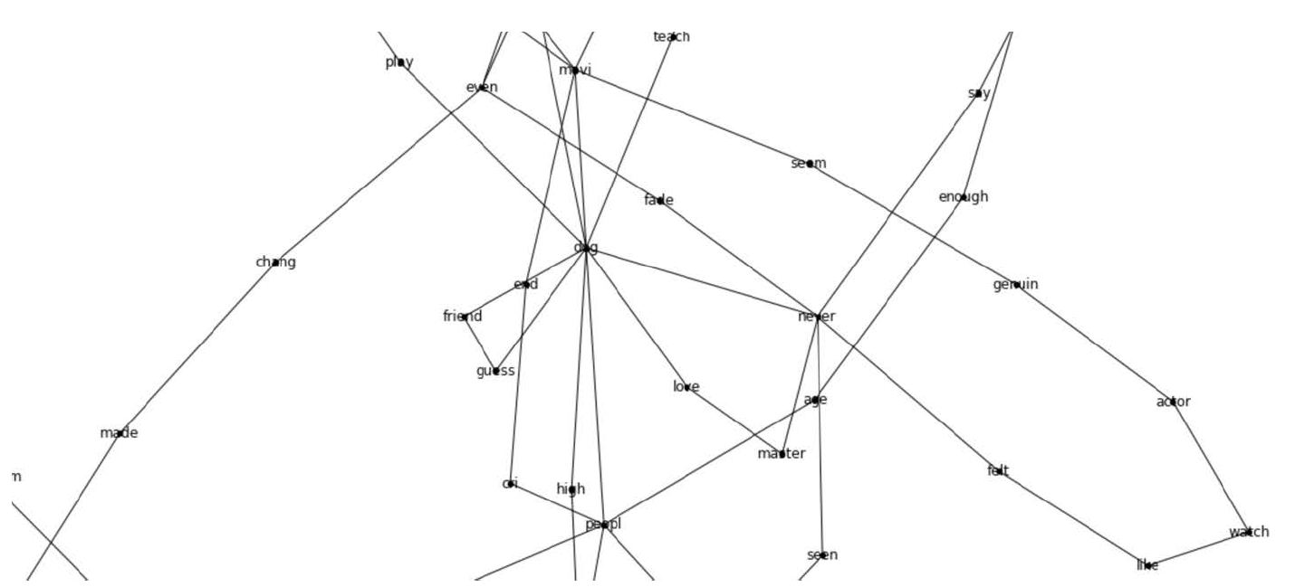
Model
K- Nearest-Neighbors
Multi-layer Perceptron
Random Forest Classifiers
Illustration – A network graph is being built for each movie and review

Slide 7
Results & Reliability
Sensitivity Metric: The ratio of the True Positives to the total number of the (True Positives + False Negatives).
F1 score as the metric to choose the best model
Random Forest Classifier with the ‘Gini’ criterion emerged as the champion model with an F1 score of 0.69.
The sensitivity of the model is pegged at 85.6% and the specificity at 72.1%.

Slide 8
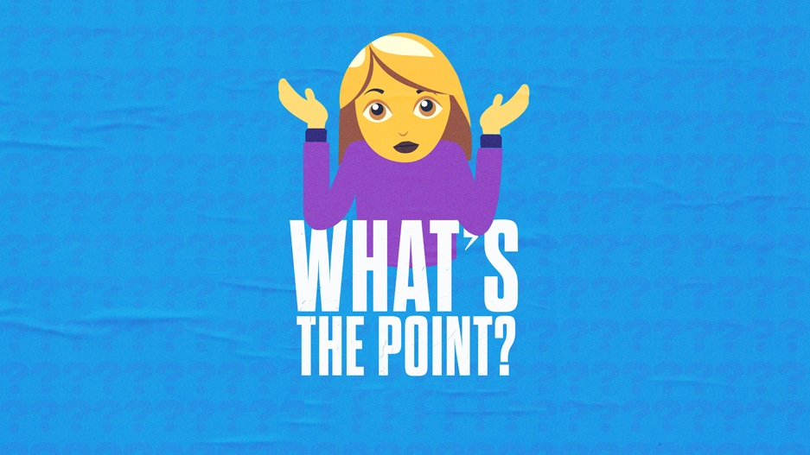
Along with being detrimental to viewer experience, these revelations are hurting the entertainment industry by causing people to lose interest in a particular film, resulting in the loss of revenue for the filmmakers.
With the help of this model, the entertainment industry can detect if a review contains a spoiler or not.
Either the reviewer can be prompted that he/she is mentioning a spoiler and therefore, it must be tagged as a ‘spoiler’, or the reader of the review can be made aware of the fact that the review features a spoiler.
Cinelytic supports studios and independent content companies to make faster and better informed greenlight, acquisition, and release decisions.
The system also crunches script summaries, character descriptions, and length. Overall, there are 19 attributes the platform analyzes to project its box office performance and other future revenues. In these extremely complex calculations, executives try to estimate how much a film may earn across a wide range of territories, what kind of deals to sign with distributors, and how to create a reasonable budget that maximizes chances of success.

Slide 9

References:
Mengting Wan, Rishabh Misra, Ndapa Nakashole and Julain McAuley. 2013. “Spoiler Alert: Machine Learning Approaches to Detect Social Media Posts with Revelatory Information.” Florence, Italy: Association for Computational Linguistics.
Jordan Boyd-Graber, Kimberly Glasgow, and Jackie Sauter Zajac. 2019. “Fine-Grained Spoiler Detection from Large-Scale Review Corpora.” Proceedings of the 57th Annual Meeting of the Association for Computational Linguistics, 2605–2610. Florence, Italy: Association for Computational Linguistics. Montreal, Quebec, Canada: ASIST
IMDB Spoiler Dataset - https://www.kaggle.com/rmisra/imdb-spoiler-dataset
Sungho Jeon, Sungchul Kim, and Hwanjo Yu. 2013. “Spoiler detection in TV program tweets.”. South Korea: Department of Computer Science and Engineering, POSTECH
Directed by
Easwar Manikanta. N
(U02793943)

